Slide 1
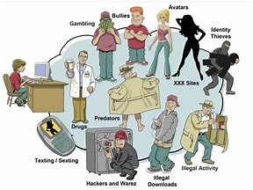

LEGAL, Ethical,
and Societal
Issues in Media
And
Information

Slide 2

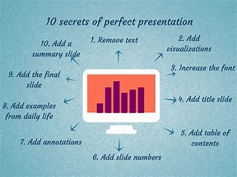
Today’s Presentation
Copy right
Fair
Plagiarism
Netiquette

Slide 3

Objectives
Identify the importance about legal,
ethical, and societal issues in media
and information
Examine the given examples
Develops a clear understanding about the consequences, advantages, and disadvantages

Slide 4

COPY RIGHT
is a legal word use to express the ownership rights that authors and artists have to their creative works.

Slide 5
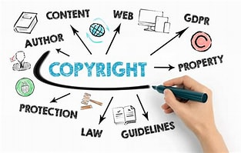


Importance of copyright
by allowing the author, professor, or researcher who created the work to prevent its unauthorized or uncredited use, it helps to preserve the value of their work.

Slide 6
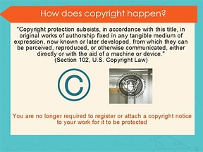

Example of copy Right
Poems
Novels
Computer
Software Songs

Slide 7
How to Avoid Copy Right
Receive a permission Use Image from public Domain Give Credit
Review ownership rights on social media pages Consider buying consent

Slide 8

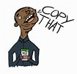
What can we copy?
The Copy Right holder has given you
Permission to copy the work
Whose Copy Right has expired
Your Copying is permitted by Fair Use

Slide 9
Copy Right Infringement
Is the use of work protected by copyright without permission for a usage where such permission is required, thereby infringing certain exclusive rights granted to the copyright holder, such as the right to reproduce, distribute, display or perform the protected work, or to make derivative works.

Slide 10
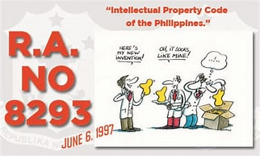
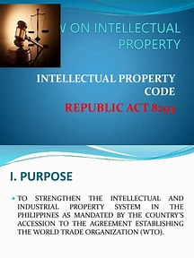
Republic Act No. 8293
Copying original and intellectual
Creations is considered as copyright
Infringement and is punishable under Republic Act No. 8293, otherwise known as the intellectual Property Code of the Philippines

Slide 11
FAIR USE
Allows users to reuse
Copyright-protected
Material without
Permission.

Slide 12
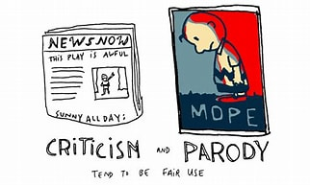
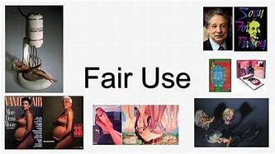
Fair Use Examples
Criticism
Commentary
News Reporting
Parody
Teaching

Slide 13
4 Factors of Fair Use
1. Purposes and character of uses
2. Amount and sustainability of work used
3. Nature of the copyrighted work
4. Effect of your use on the market.

Slide 14
Advantage and Disadvantages of Fair Use
Advantages
Without their approval, you can still obtain the owner’s work and leave a citation.
Disadvantages
People will be greedy getting work of other
People make profit for it

Slide 15
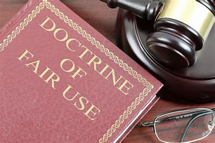
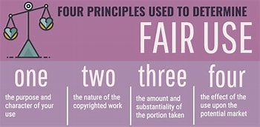
IMPORTANCE OF FAIR USE
1. Fair use prevent copyright law form stilfling research and cristicism.
2. The purpose is to balance the right way of
using work of others.

Slide 16
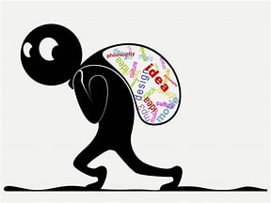
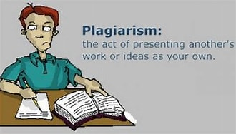
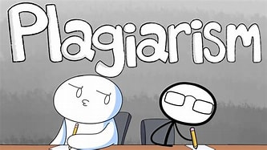
PLAGIARISM
The practice of taking someone else’s work or ideas and passing them off as one’s own

Slide 17
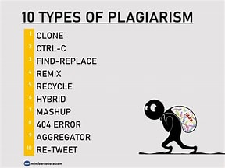
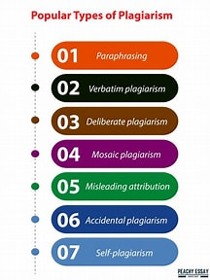
7 common types of plagiarism
Complete Plagiarism
The most severse form of plagiarism where a researcher takes a manuscript or study that someone else created, and submit it under his or her name. it is equivalent to intellectual theft and stealing
Direct Plagiarism
Direct plagiarism is when someone plagiarizes another making any effort to acknowledge that the information come from an outside source.

Slide 18
Paraphrasing
Plagiarism
This types of plagiarism arises when you change the words, but you still present another person’s concept as your own
Self Plagiarism
Self-plagiarism is defined in which the writer republishes a reuses protions of a previously written text while authoring a new work.

Slide 19
Patchwork
Plagiarism
Direct “patchwork” plagiarism occurs when a writer copies material from several writers and rearranges that material with no attempt to acknowledge the original sources
Source based
Refers to intances when misteading sources are involed.
Accident
Occurs when a neglects to cite their sources, or misquotes their sources, or unintentionally paraphrase a source by using similar words, group of words and sentences.

Slide 20
Robert Van Winkle “vanilla ice”
Former First Lady Melania
Trump(2016)
Former Senator Joe Biden (1987)
Co-Foundet David Mikkelson
(2021)

Slide 21
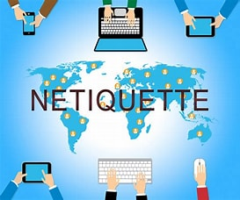
NETIQUETTE
Derived from the word “etiquette which refers to the general rules or conventions of correct and polite behavior in social settings and
Situations. It is thus the practice of exercising polite and considerate behaviour in online contexts such as internet discussion boards and personal email

Slide 22
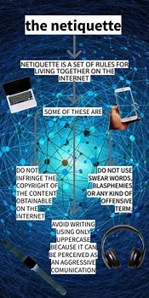
Importance of Netiquette
Online communication can be made more productive with the use of netiquette, which also helps people stay clear or confusion and potential confrontation. Without a solid grasp of netiquette, you run the risk of unintentionally engaging in abusive or cyberbully behaviour

Slide 23
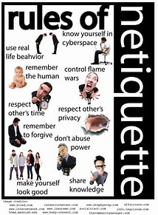
Core Rules in Netiquette
Remember the Human
Adhere to the same standards of behaviour online that you follow in real life
Know where you are in cyberspace
Respect other people’s time and bandwidth
Make yourself look good online
Share expert knowledge
Help keep flame wars under control
Respect other people’s privacy
Don’t abuse your power
Be forgiving of other people’s mistakes

Slide 24
THANK YOU!

Slide 25

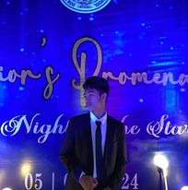
MEMBERS:
R-JAY U. MAGNO
MARK IAN TEVES

